Slide 1
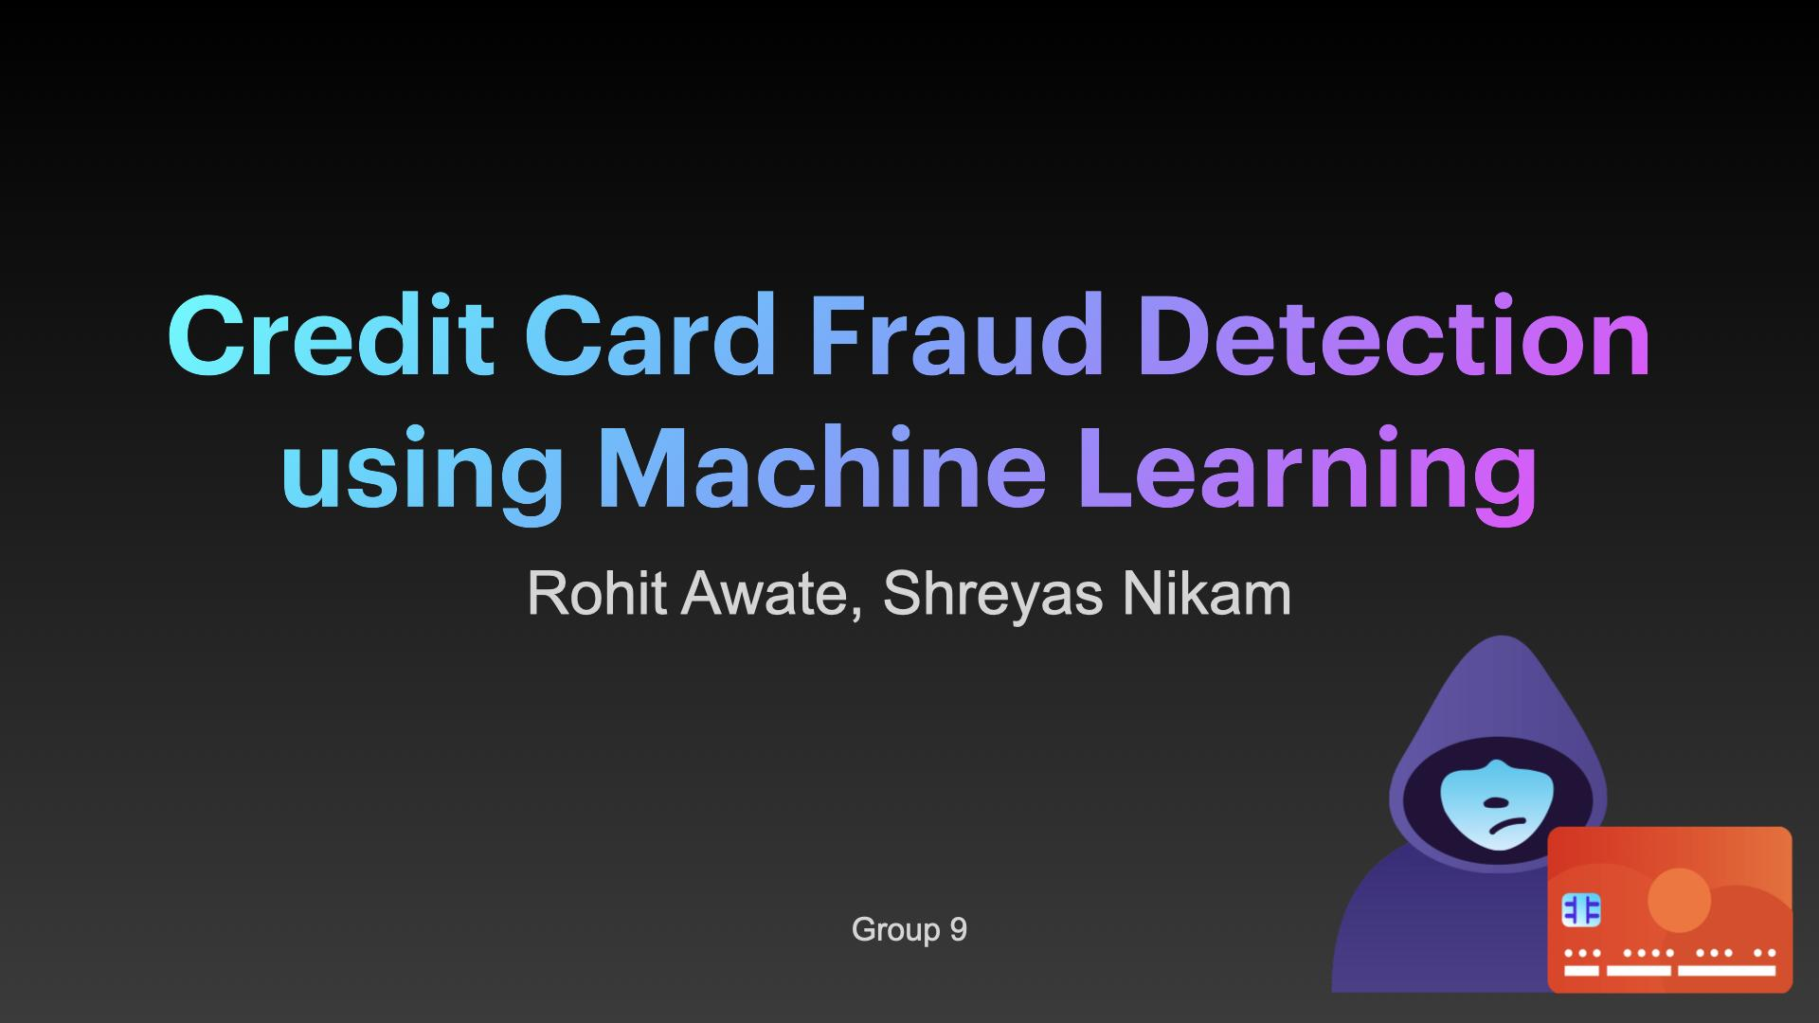

Credit Card Fraud Detection using Machine Learning
Rohit Awate, Shreyas Nikam
Group 9

Slide 2
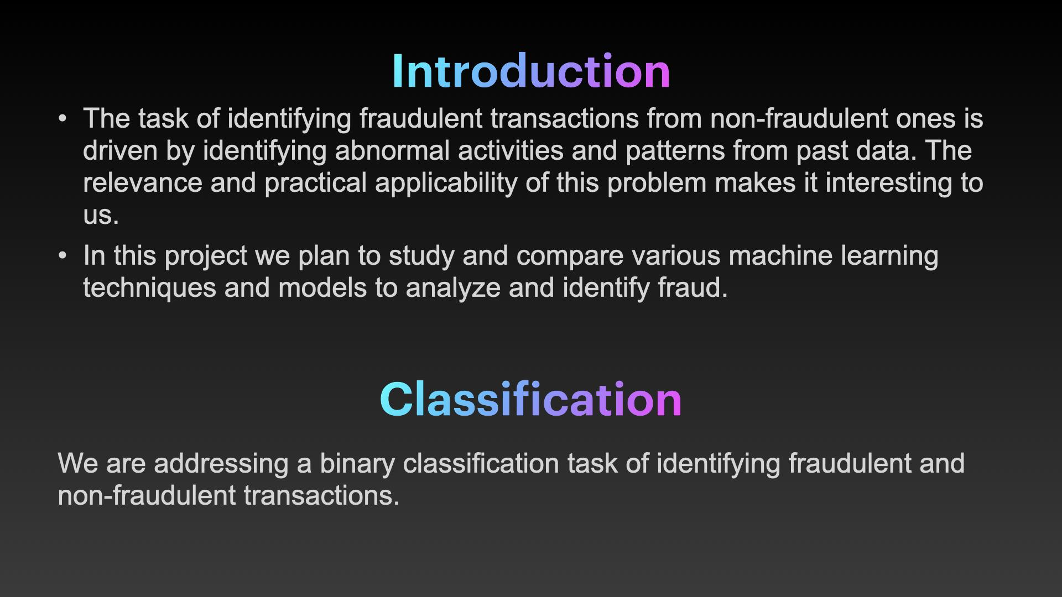
Introduction
The task of identifying fraudulent transactions from non-fraudulent ones is driven by identifying abnormal activities and patterns from past data. The relevance and practical applicability of this problem makes it interesting to us.
In this project we plan to study and compare various machine learning techniques and models to analyze and identify fraud.
Classification
We are addressing a binary classification task of identifying fraudulent and non-fraudulent transactions.

Slide 3
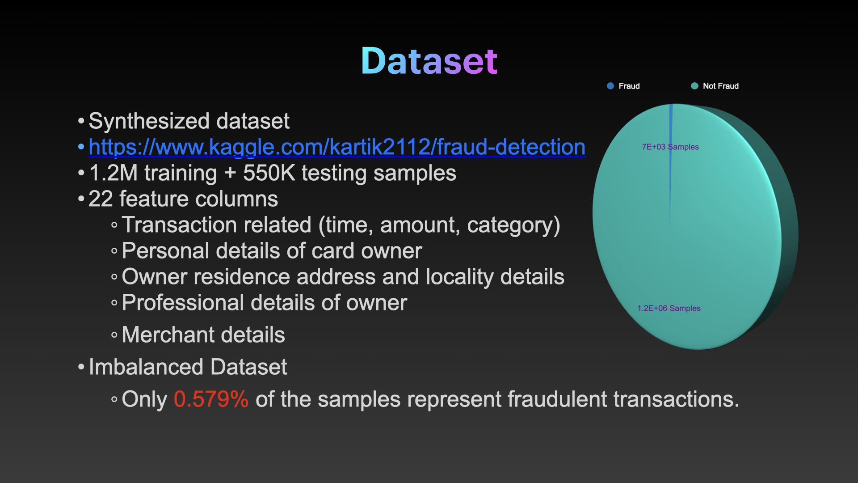

Dataset
Synthesized dataset
https://www.kaggle.com/kartik2112/fraud-detection
1.2M training + 550K testing samples
22 feature columns
Transaction related (time, amount, category)
Personal details of card owner
Owner residence address and locality details
Professional details of owner
Merchant details
Imbalanced Dataset
Only 0.0625% of the samples represent fraudulent transactions.

Slide 4
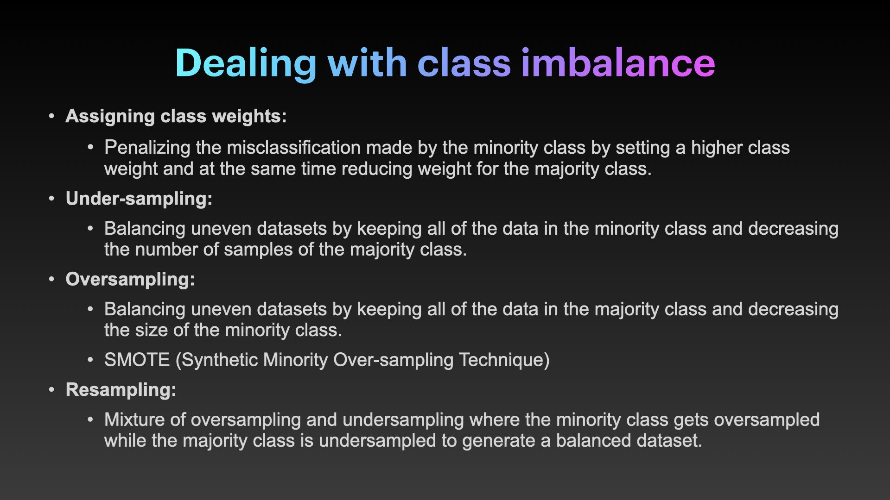
Dealing with class imbalance
Assigning class weights:
Hyper-parameter tuning for the class weights
Under-sampling:
Balancing uneven datasets by keeping all of the data in the minority class and decreasing the number of samples of the majority class.
Oversampling:
Balancing uneven datasets by keeping all of the data in the majority class and decreasing the size of the minority class.
SMOTE (Synthetic Minority Over-sampling Technique)
Scikit-learn’s resample

Slide 5
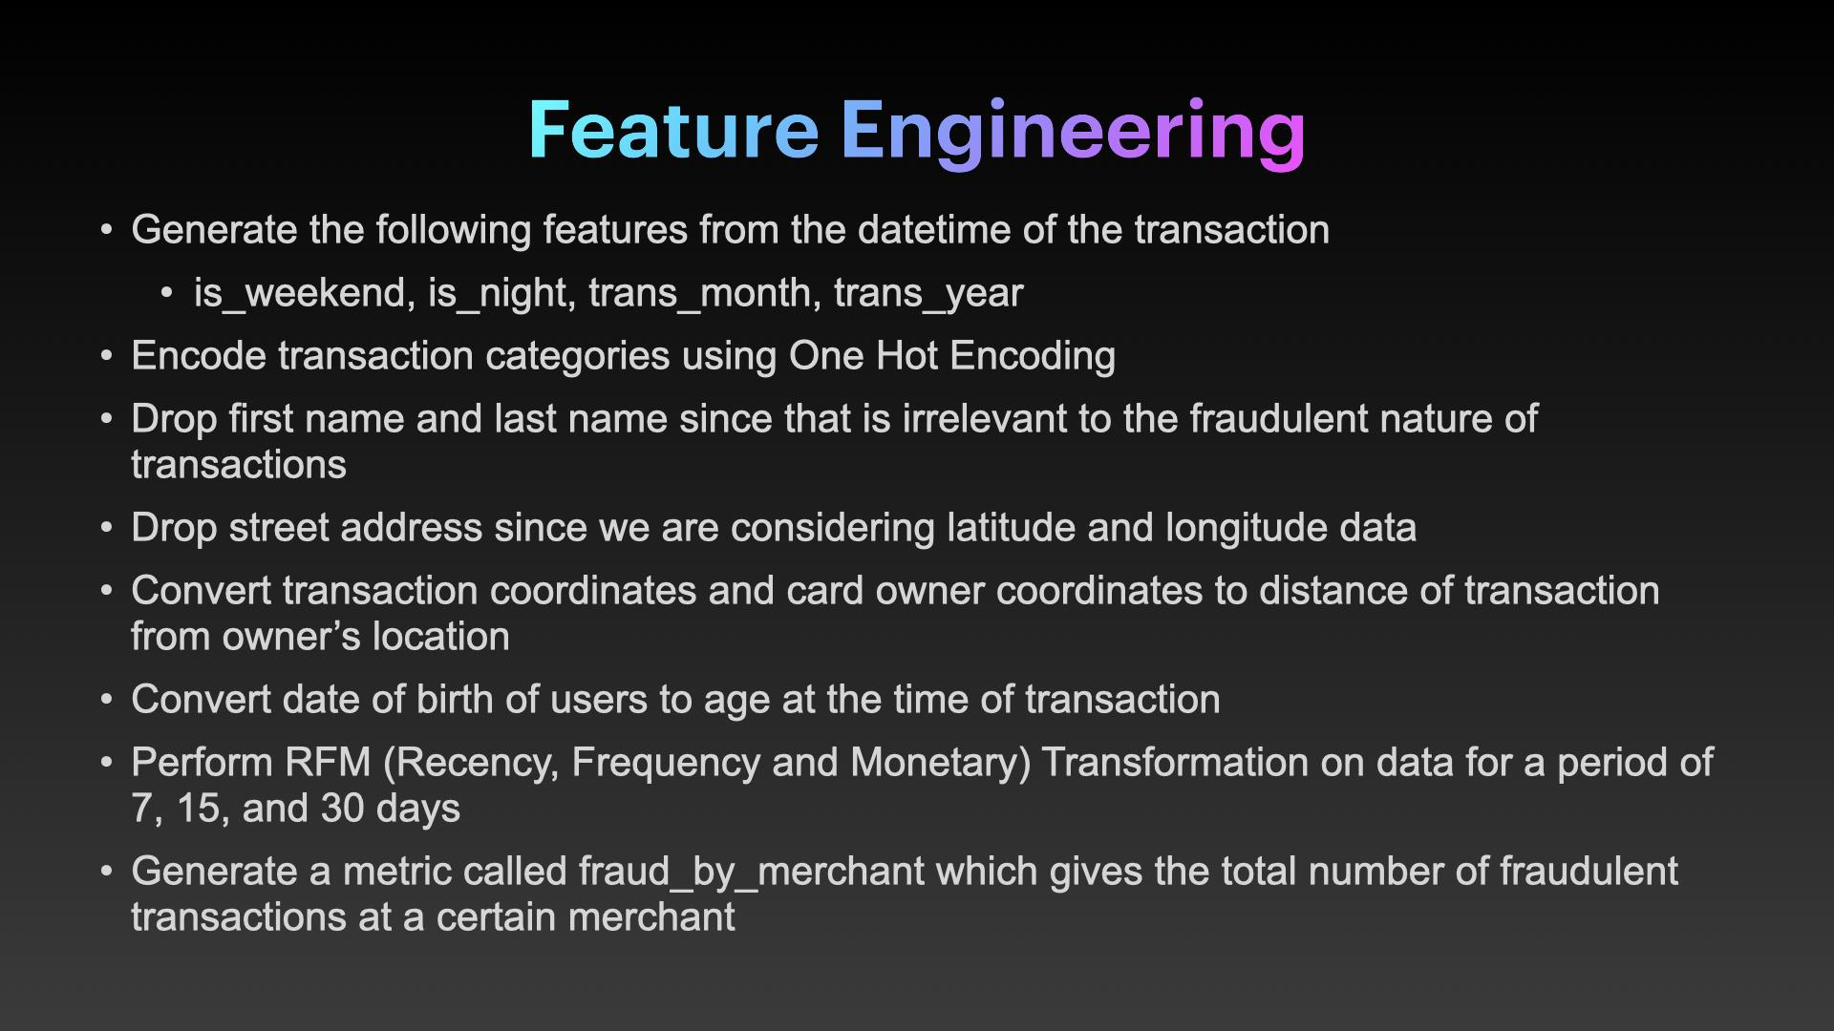
Feature Engineering
Generate the following features from the datetime of the transaction
is_weekend, is_night, trans_month, trans_year
Encode transaction categories using One Hot Encoding
Drop first name and last name since that is irrelevant to the fraudulent nature of transactions
Drop street address since we are considering latitude and longitude data
Convert transaction coordinates and card owner coordinates to distance of transaction from owner’s location
Convert date of birth of users to age at the time of transaction
Perform RFM (Recency, Frequency and Monetary) Transformation on data for a period of 7, 15, and 30 days
Generate a metric called fraud_by_merchant which gives the total number of fraudulent transactions at a certain merchant

Slide 6
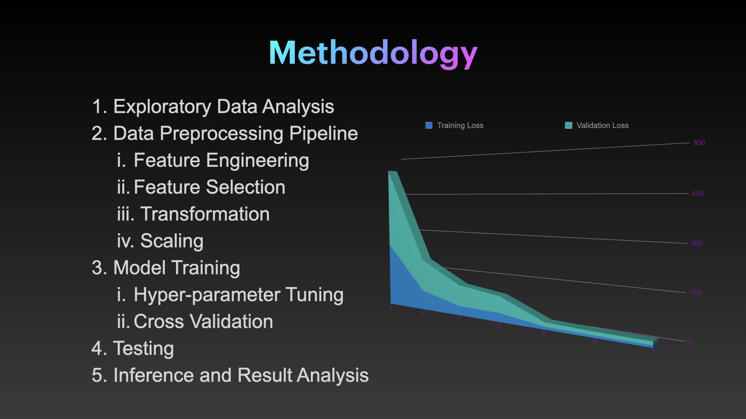
Methodology
Exploratory Data Analysis
Data Preprocessing Pipeline
Feature Engineering
Feature Selection
Transformation
Scaling
Model Training
Hyper-parameter Tuning
Cross Validation
Testing
Inference and Result Analysis

Slide 7
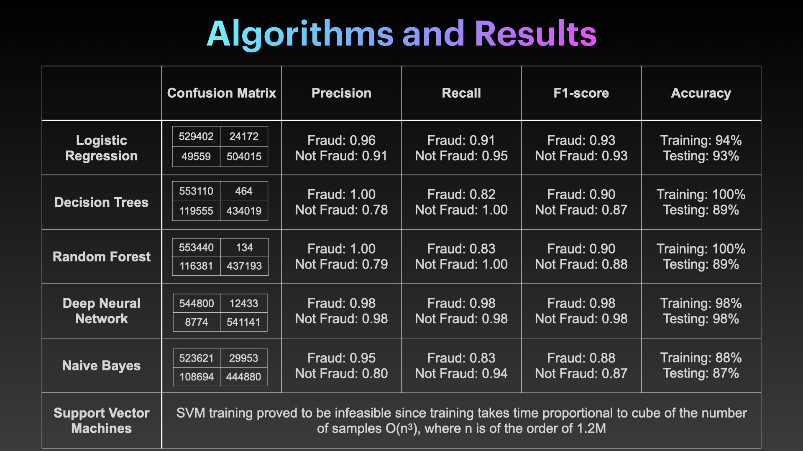
Algorithms and Results
 | Confusion Matrix | Precision | Recall | F1-score | Accuracy
Logistic Regression |  | Fraud: 0.92 Not Fraud: 0.96 | Fraud: 0.96 Not Fraud: 0.93 | Fraud: 0.94 Not Fraud: 0.94 | Training: 94% Testing: 93%
Decision Trees |  | Fraud: 1 Not Fraud: 1 | Fraud: 1 Not Fraud: 1 | Fraud: 1 Not Fraud: 1 | Training: 100% Testing: 89%
Deep Neural Network |  | Fraud: 0.98 Not Fraud: 0.98 | Fraud: 0.98 Not Fraud: 0.98 | Fraud: 0.98 Not Fraud: 0.98 | Training: 98% Testing: 98%
Support Vector Machines | SVM training proved to be infeasible since training takes time proportional to cube of the number of samples O(n³), where n=1.2M
529402 | 24172
49559 | 504015
553110 | 464
119555 | 434019
544800 | 12433
8774 | 541141

Slide 8
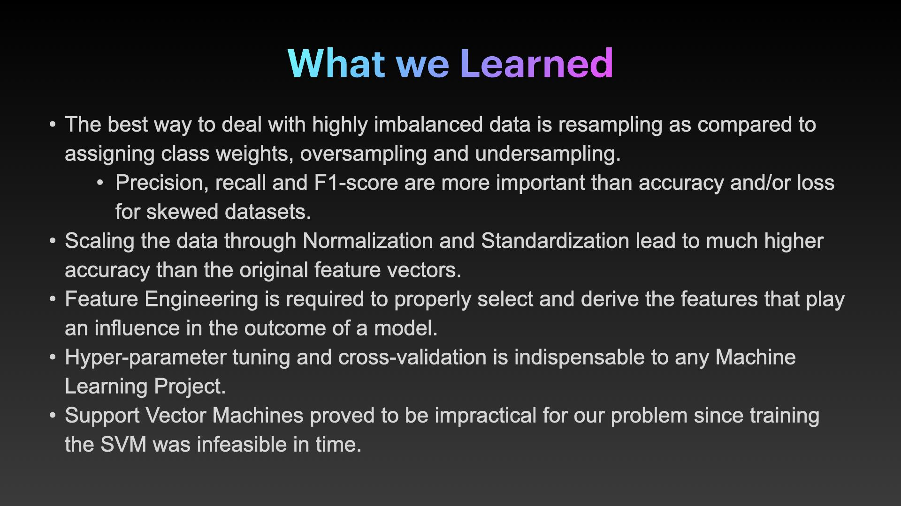
What we Learned
The best way to deal with highly imbalanced data is oversampling as compared to assigning class weights and undersampling.
Precision, recall and F1-score are more important than accuracy and/or loss for skewed datasets.
Feature Engineering is required to properly select and derive the features that play an influence in the outcome of a model.
Hyper-parameter tuning and cross-validation is indispensable to any Machine Learning Project.
Support Vector Machines proved to be impractical for our problem since training the SVM was infeasible in time.

